Slide 1
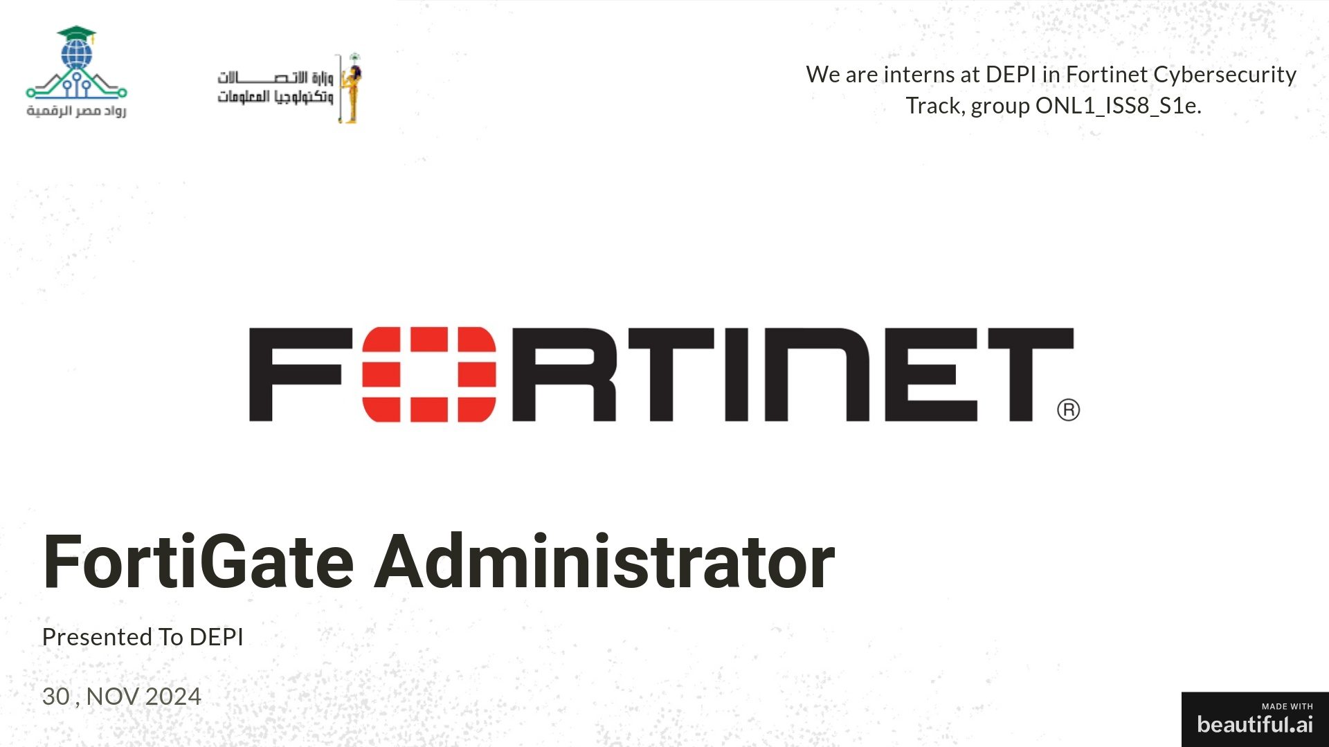

http://www.linkedin.com/in/al-maghraby

Slide 2
We will discuss the NAT lab
In FortiGate Administrator

Slide 3

Content:
Objective of the lab
Topology
Components used
Steps of the lab
Testing the lab
The results
Notes:
3

Slide 4
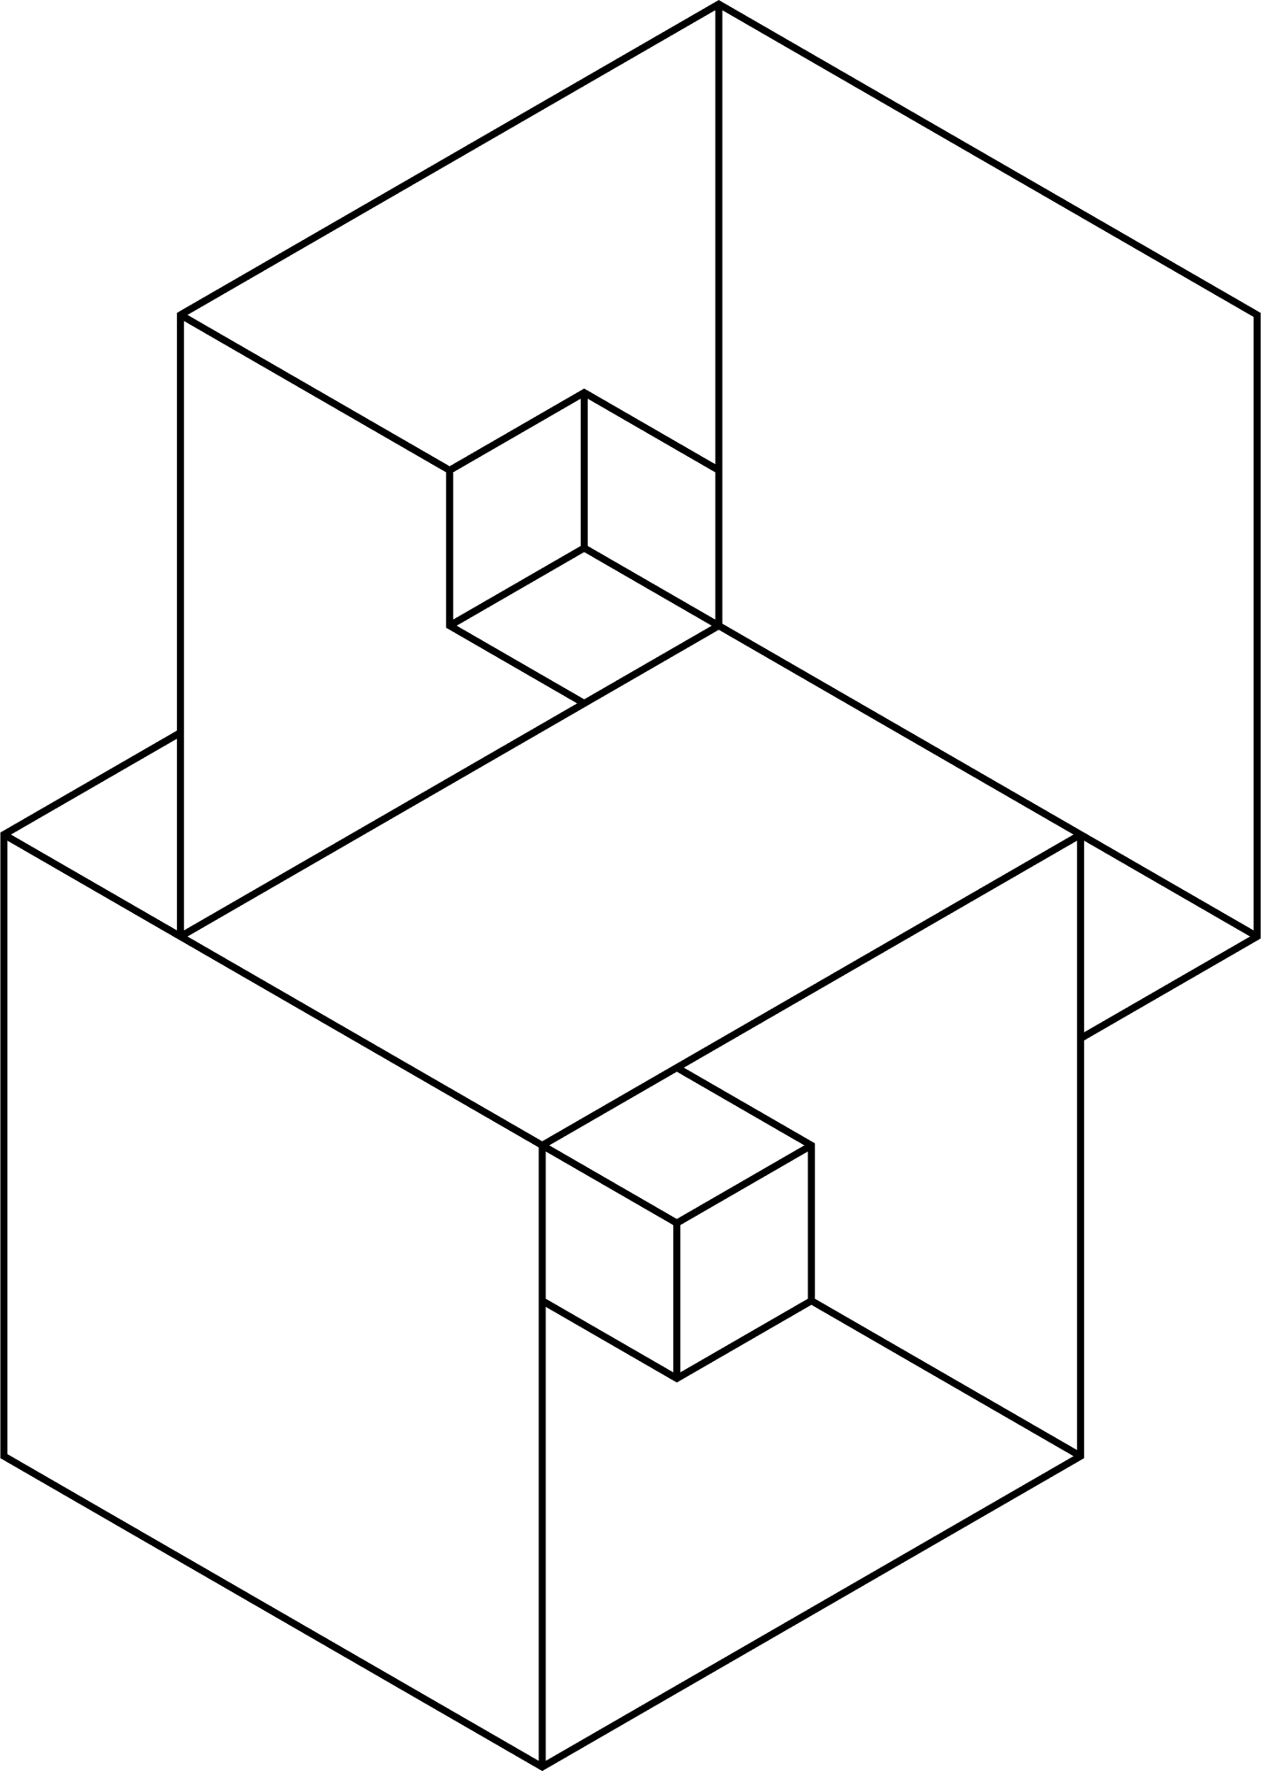
Objective of the lab
The NAT (Network Address Translation) lab focuses on configuring and testing:
DNAT (Destination NAT) using Virtual IP (VIP).
SNAT (Source NAT) using IP pools.
Central NAT policies for both SNAT and DNAT.
The goal is to understand how NAT is applied in FortiGate devices to control traffic flow between networks.
Notes:
4

Slide 5
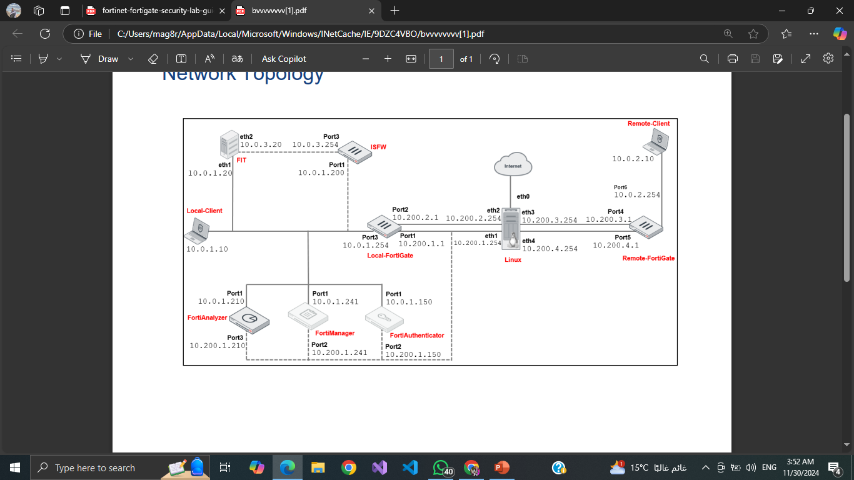
Topology
The lab involves:
A Local-FortiGate and Remote-FortiGate connected through a Linux router.
Two clients: Local-Client VM and Remote-Client VM.
NAT configurations route traffic from public to private addresses and vice versa.
Notes:
5

Slide 6
Components Used
FortiGate firewalls (Local and Remote).
Linux router for inter-device communication.
Client VMs for testing (Local and Remote).
Browser tools to simulate web traffic.
Configuration files for initial setup.
Notes:
6

Slide 7
Steps of the NAT Lab
Notes:
7

Slide 8
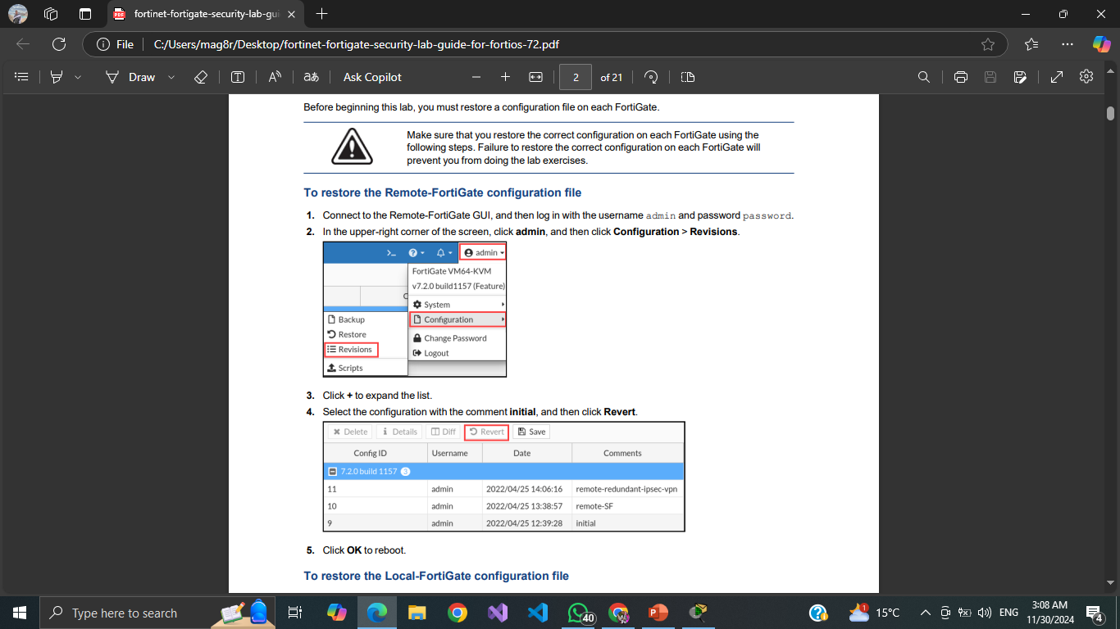
Prerequisite Setup
Restore default configurations for Local-FortiGate and Remote-FortiGate.

Slide 9
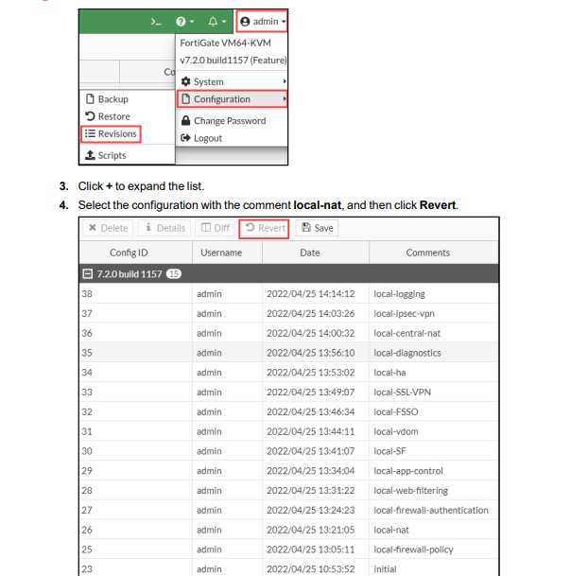
To restore the Local-FortiGate configuration file

Slide 10
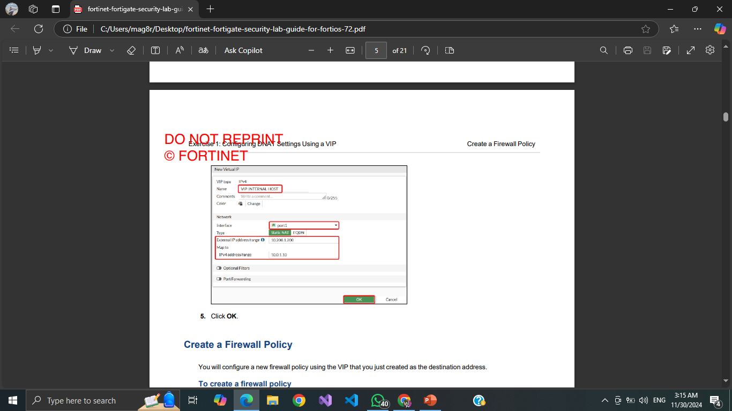
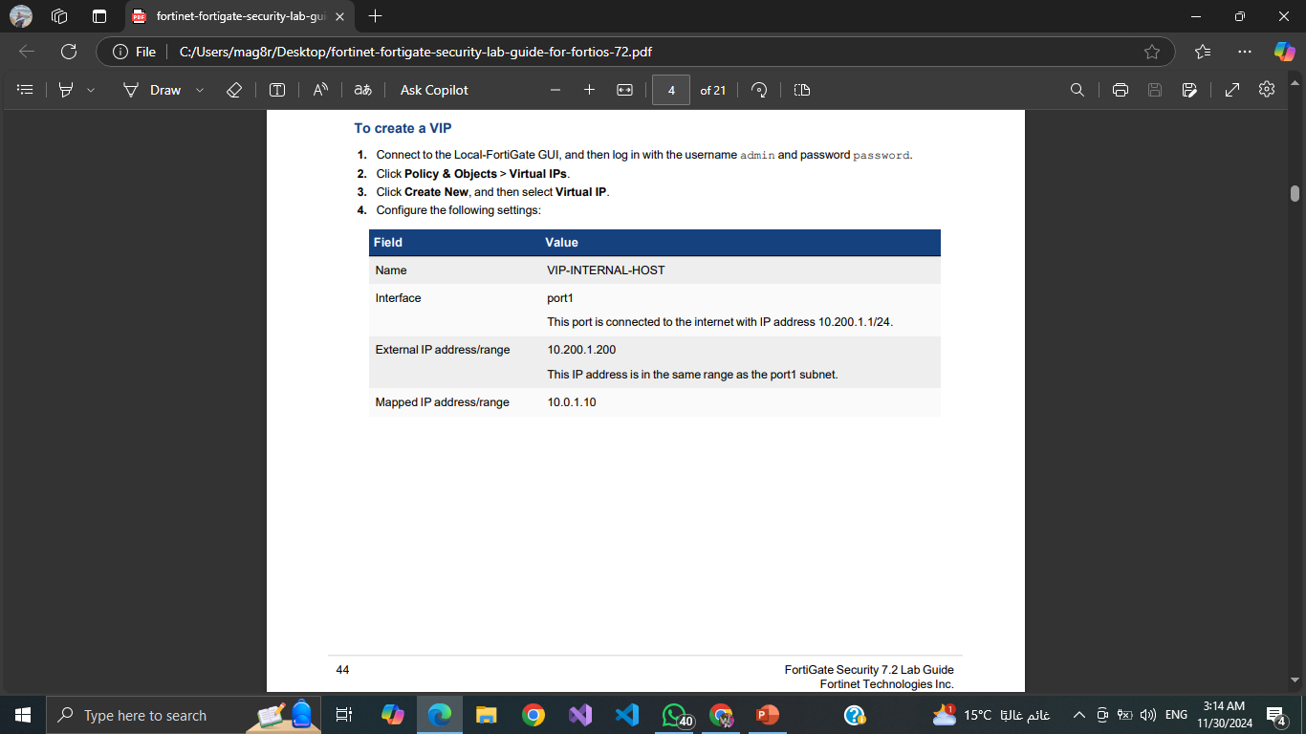
Configuring DNAT with VIP:
Create a Virtual IP (VIP) mapping external (10.200.1.200) to internal (10.0.1.10).
Configure a firewall policy to use this VIP for traffic redirection.
Notes:
Video URL: https://videos.pexels.com/video-files/853889/853889-hd_1920_1080_25fps.mp4

Slide 11
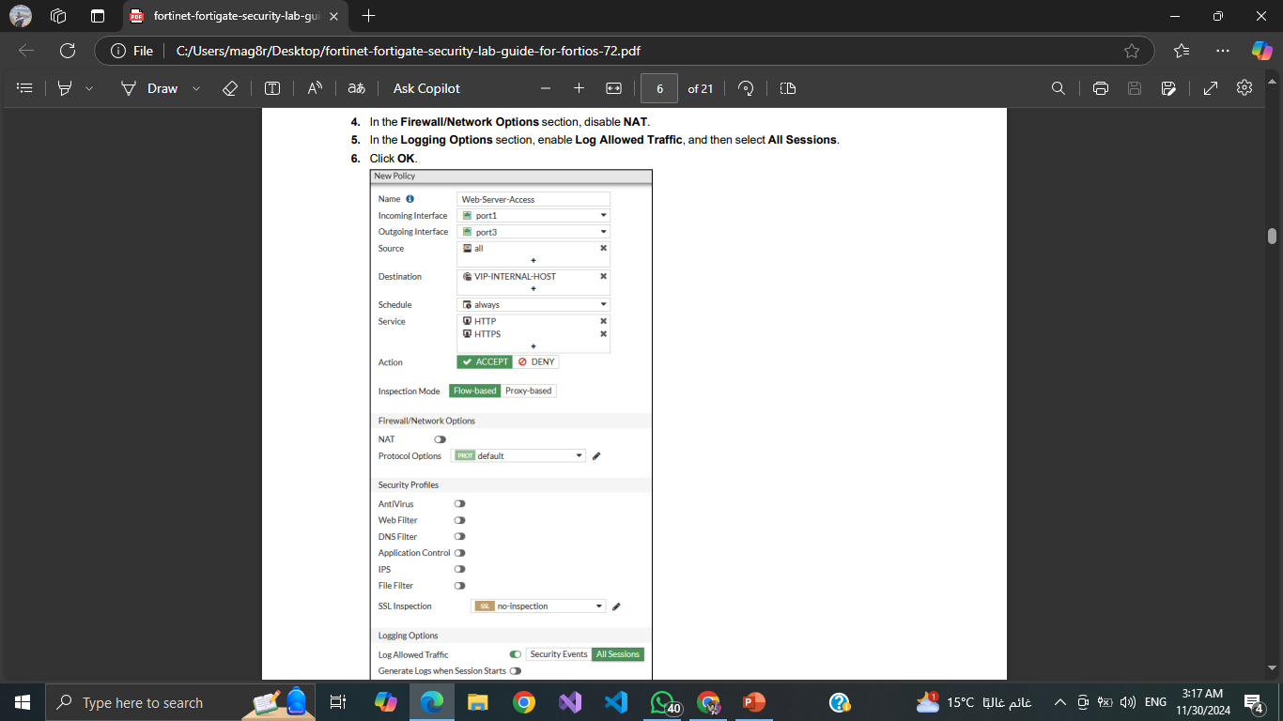
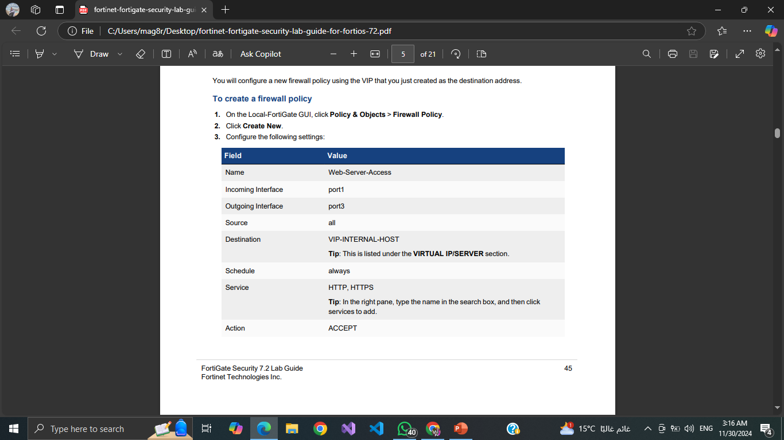
Create a Firewall Policy

Slide 12
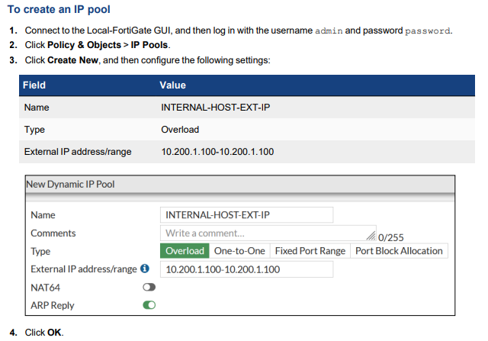
Using Dynamic NAT With IP Pools
Create an IP Pool You will create an IP pool from the range of public IP addresses available on the egress port (port1).

Slide 13
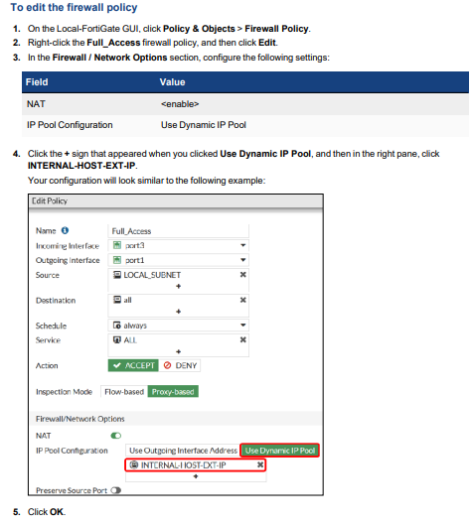
Edit a Firewall Policy to Use the IP Pool

Slide 14
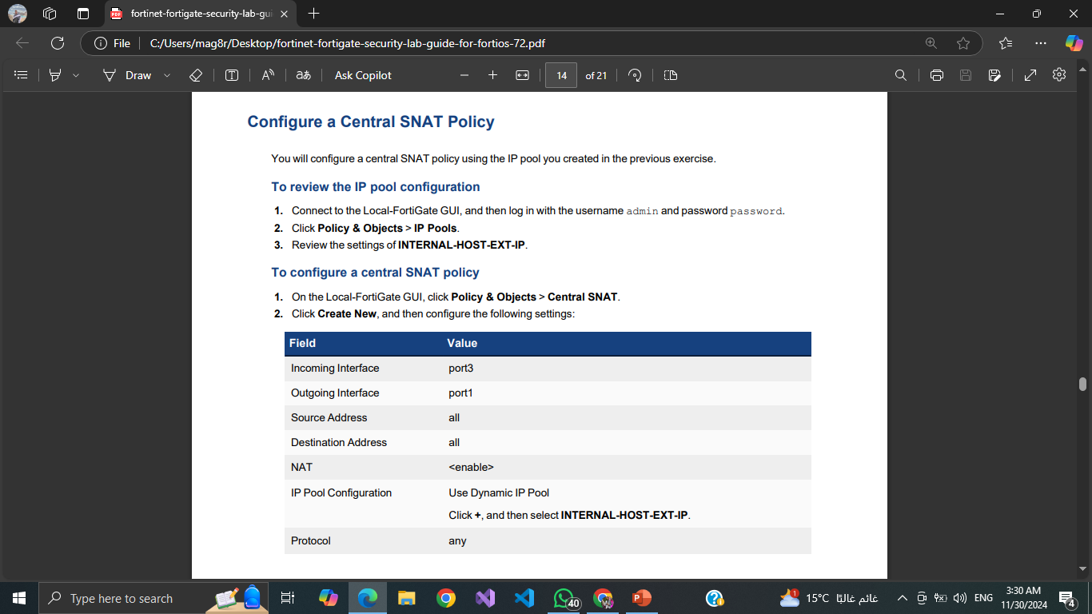
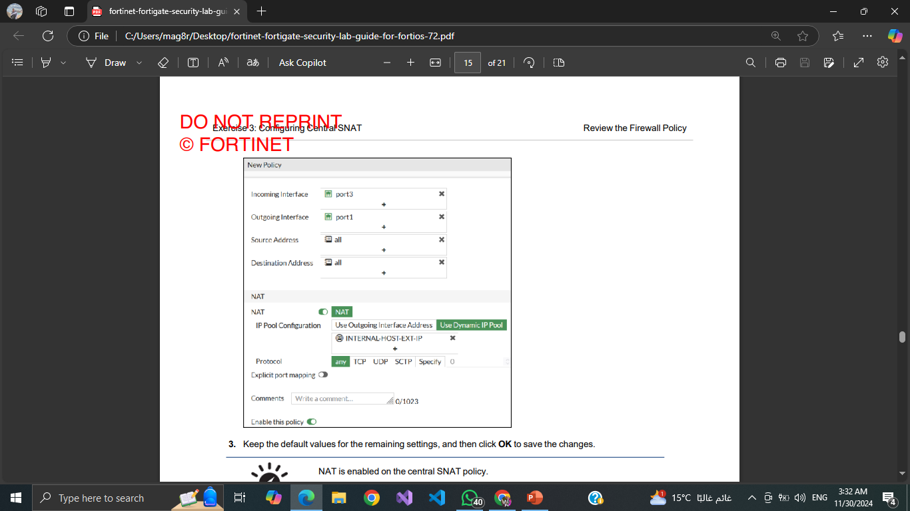
Configuring Central SNAT
A central SNAT policy is applied to multiple firewall policies, based on a configured central rule. In this exercise, you will examine how to configure a central SNAT policy and test it

Slide 15
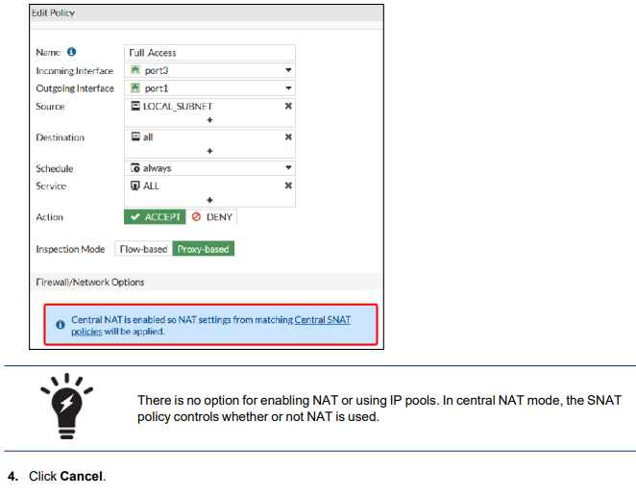
Review the Firewall Policy
To verify that NAT is enabled on the firewall policy
On the Local-FortiGate GUI, click Policy & Objects > Firewall Policy.
Right-click the Full Access firewall policy, and then click Edit.
Review the Firewall/Network Options of the Full Access policy

Slide 16

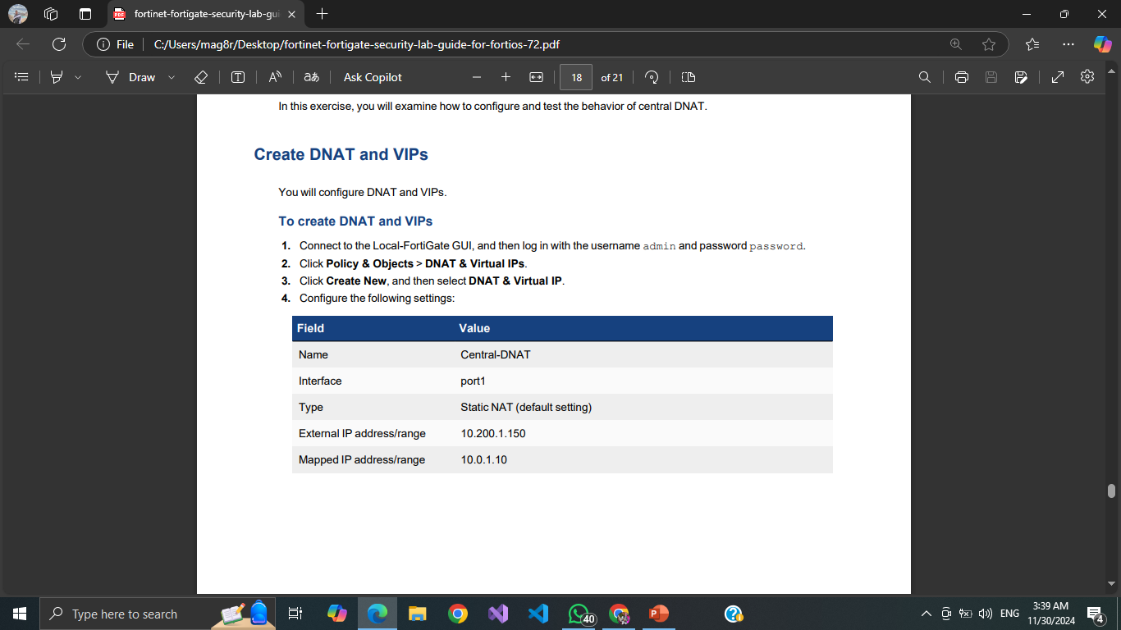
Configuring and Testing DNAT and VIPs
In firewall policy NAT, a VIP is selected in the firewall policy as the destination address. In central NAT, when you configure DNAT and VIPs, FortiGate automatically creates a rule in the kernel to allow DNAT to occur, and no additional configuration is required.

Slide 17
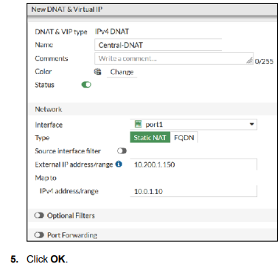
Configuring and Testing DNAT and VIPs

Slide 18
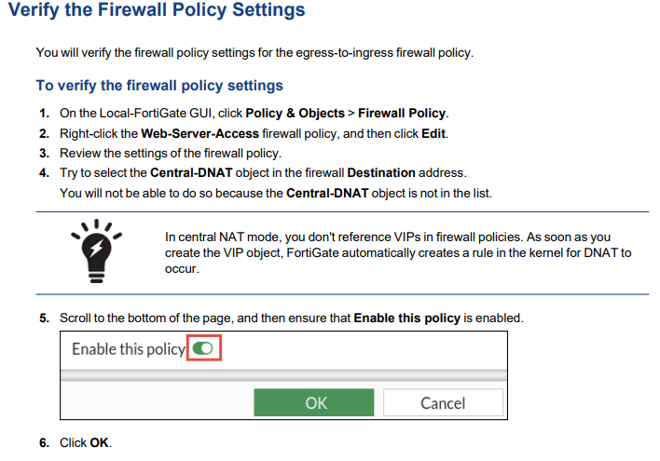
You will verify the firewall policy settings for the egress-to-ingress firewall policy
Verify the Firewall Policy Settings

Slide 19

Testing the NAT lab

Slide 20
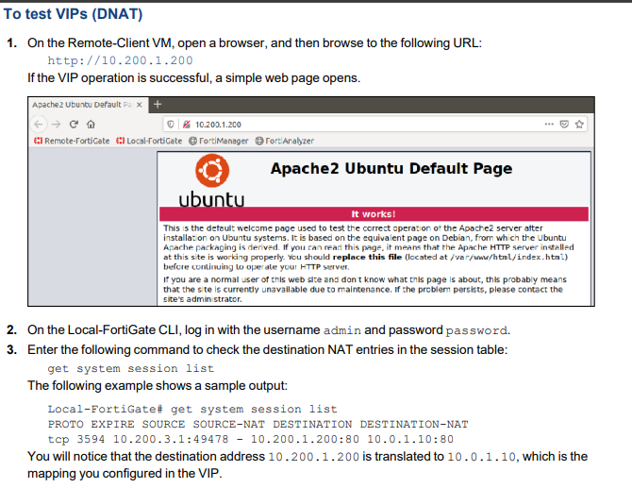
Test the VIP Firewall Policy
Now that you have configured a firewall policy with the VIP as the destination, you can test your VIP by accessing it from the Remote-Client VM, which is behind the Remote-FortiGate internal network.

Slide 21
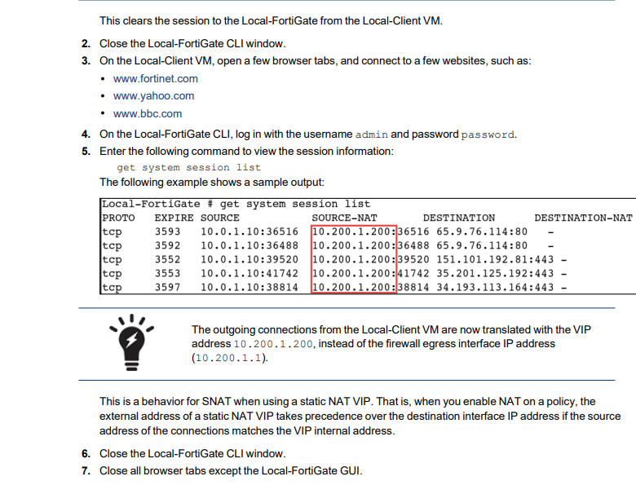
Test SNAT
To test SNAT: Return to the Local-FortiGate CLI session, and then enter the following command to clear any existing sessions: diagnose sys session clear

Slide 22
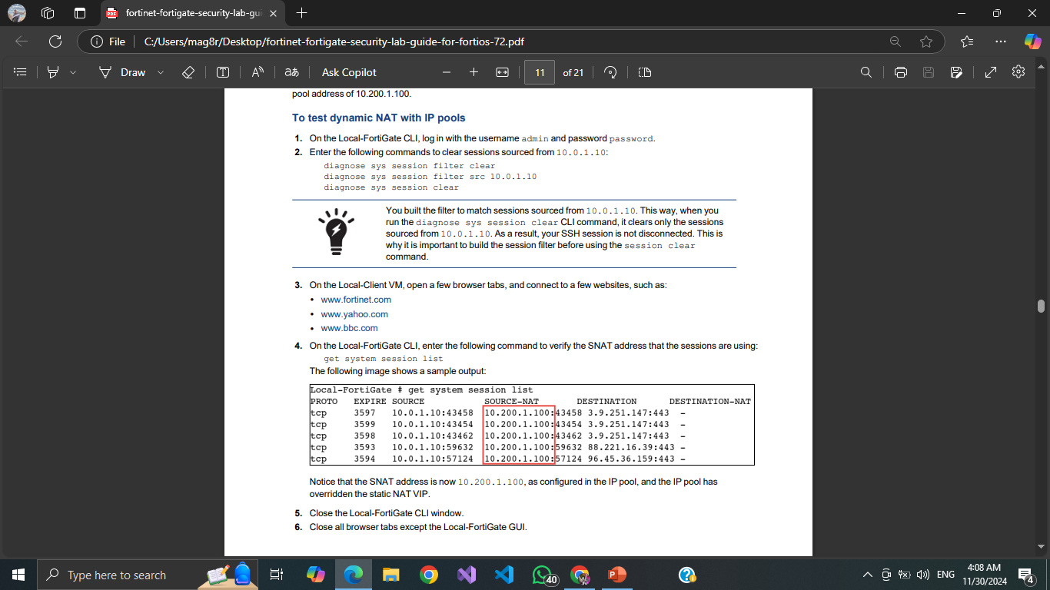
Test Dynamic NAT With IP Pools
Now that your configuration is ready, you can test dynamic NAT with IP pools by browsing to a few external sites on the internet. If successful, you will see that the Local-Client VM IP address (10.0.1.10) is translated to the IP pool address of 10.200.1.100

Slide 23
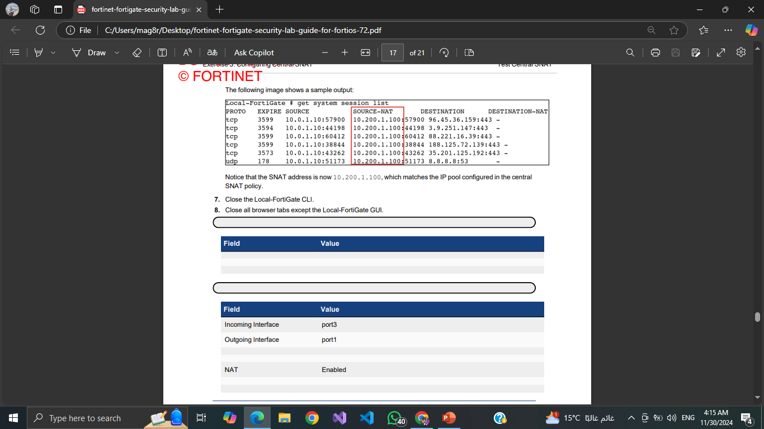
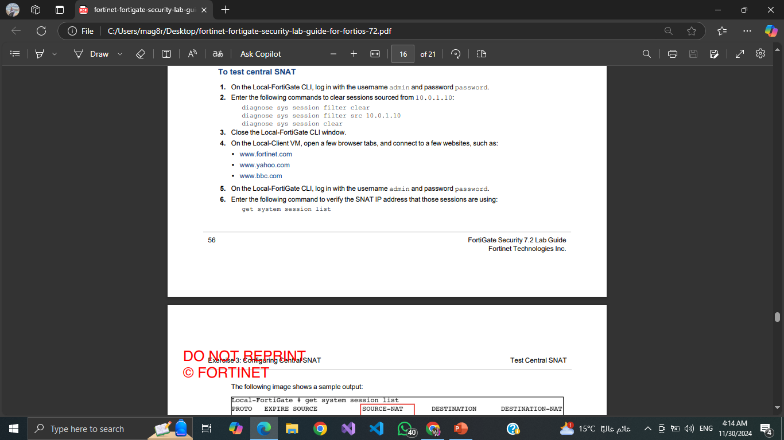
Test Central SNAT
Now that your configuration is ready, you will test the behavior of the central SNAT policy.

Slide 24
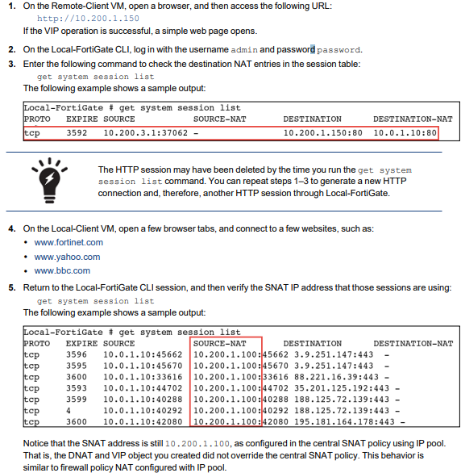
Test DNAT and VIPs
You will test DNAT and VIPs by accessing the Local-Client VM.

Slide 25

Results

Slide 26

DNAT: Traffic to 10.200.1.200 was redirected to 10.0.1.10, as shown in the session logs.
SNAT with IP Pools: Outgoing traffic from the Local-Client VM was translated to 10.200.1.100.
Central NAT: Centralized SNAT policies correctly translated source IP addresses to match the IP pool configuration.

Slide 27

THANK YOU

